Slide 1

Regional Water Planning and the 2012 State Water Plan

Slide 2
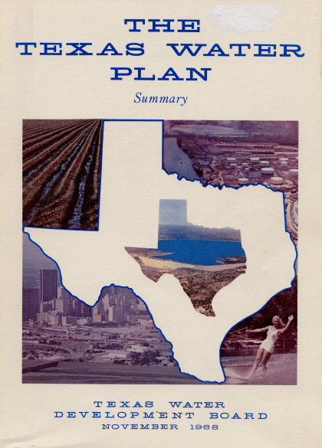
Legislative Response to Drought
1950s Drought of Record
  1957: Creation of TWDB
  $200 million Water Development Fund
Late 1990s: Another Bad Drought
  ~$6 billion economic losses in ‘96 (mostly agriculture)
  ~300 entities with threat to water supplies
  1997 & 2001: Implementation of Senate Bills 1 & 2 which created & refined regional water planning

Slide 3





State water planning

Slide 4


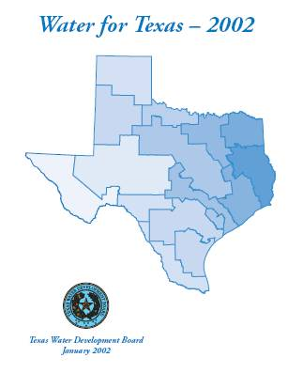
Regional water planning
Notes:
TWDB has adopted three water plans since the passage SB 1.

Slide 5
Planning assumptions
Meet drought of record water needs
50-year planning horizon
5-year planning cycle
Categories of water use: municipal, manufacturing, irrigation, mining, livestock, steam-electric power
Public participation

Slide 6
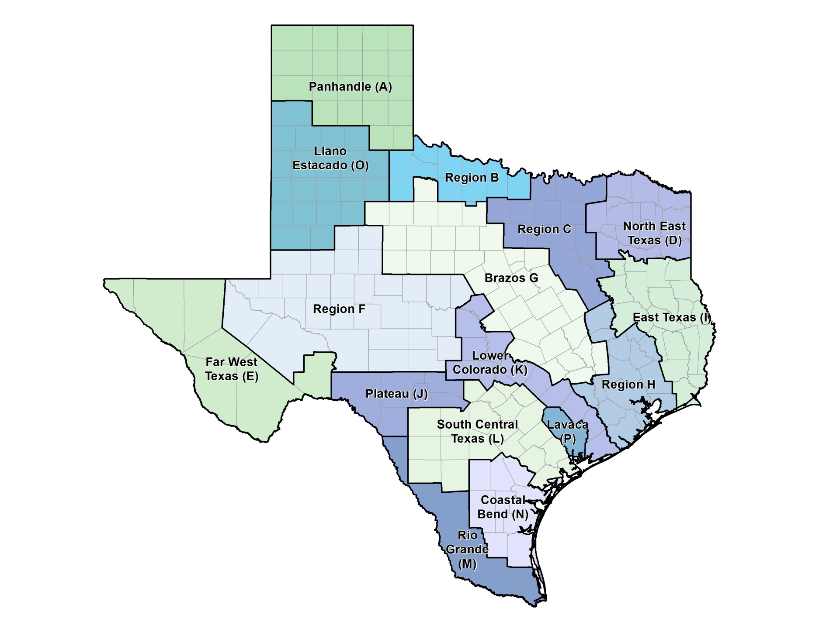
Regional water planning: 12 interests
Public
Counties
Municipalities
Industries
Agriculture
Environment
Groundwater management areas
River authorities
Electric-generating utilities
Water districts
Water utilities
Small businesses

Slide 7
Regional water planning process
Existing Water Supplies
Projected Water Demand
Surplus (+) or Need (-) for Water

Slide 8
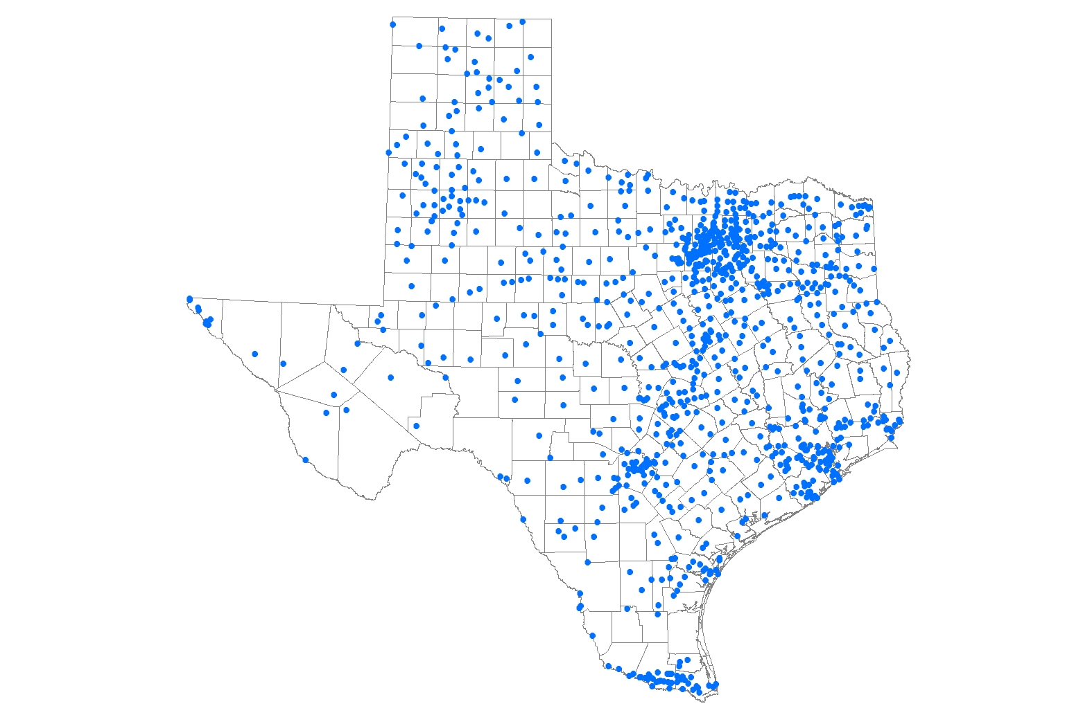
Cities
Cities: 971 (>500 pop)

Slide 9
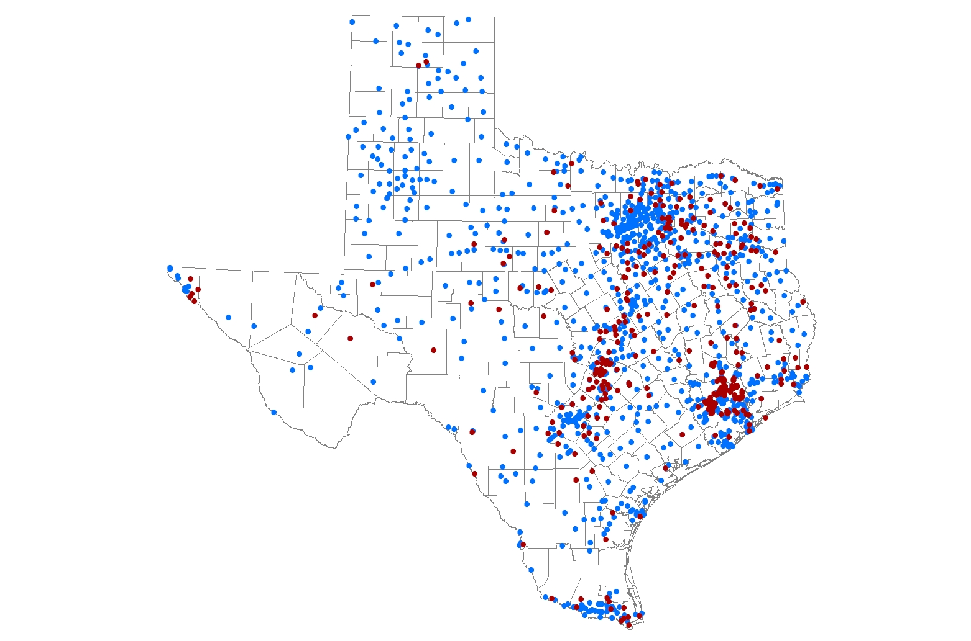
Utilities
Cities: 971
Utilities: 362

Slide 10

County-other
Cities: 971
Utilities: 362
County-Others: 254

Slide 11

Manufacturing
Cities: 971
Utilities: 362
County-Others: 254
Manufacturing: 174

Slide 12
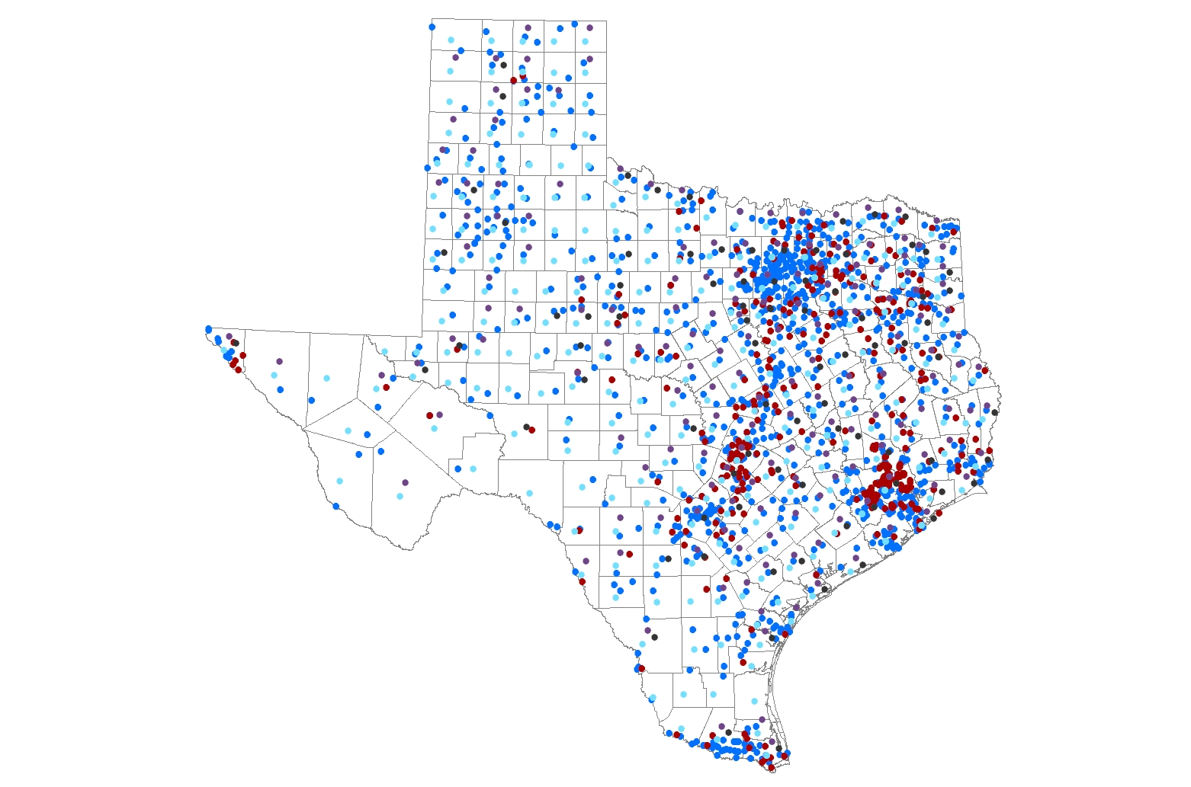
Steam-electric
Cities: 971
Utilities: 362
County-Others: 254
Manufacturing: 174
Steam-Electric: 85

Slide 13
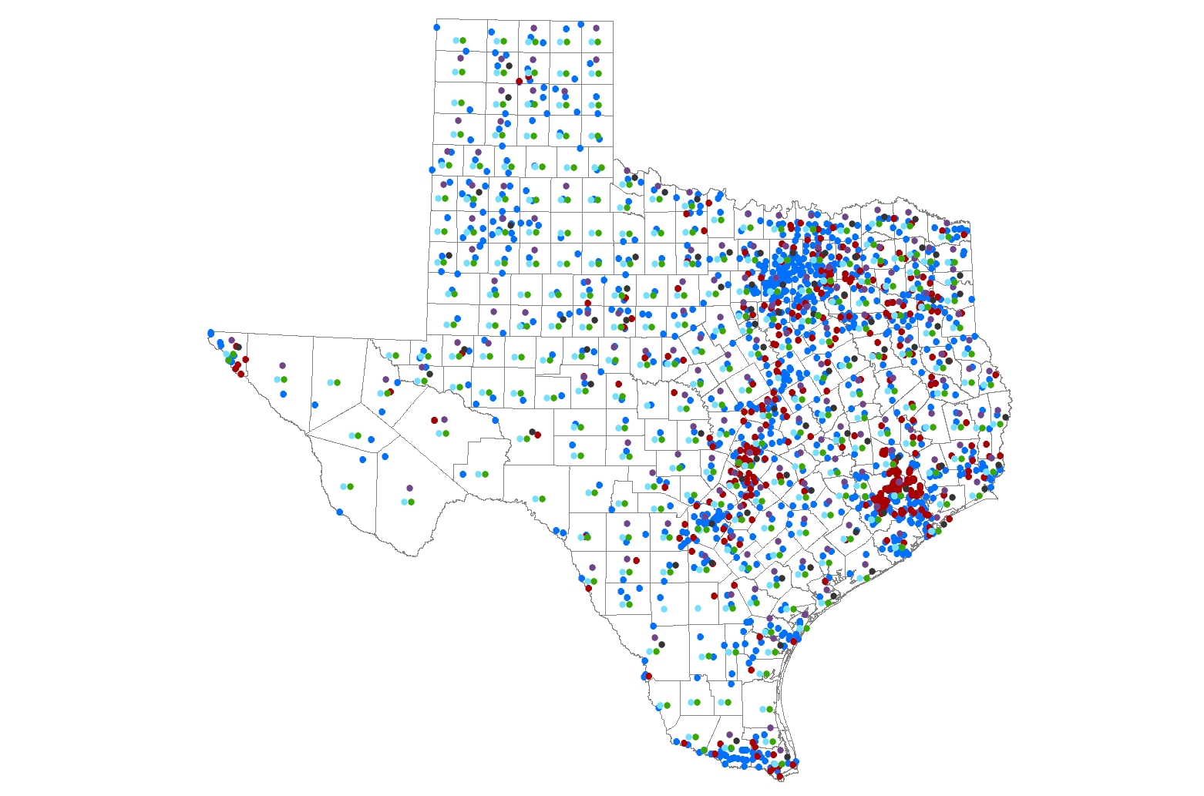
livestock
Cities: 971
Utilities: 362
County-Others: 254
Manufacturing: 174
Steam-Electric: 85
Livestock: 254

Slide 14
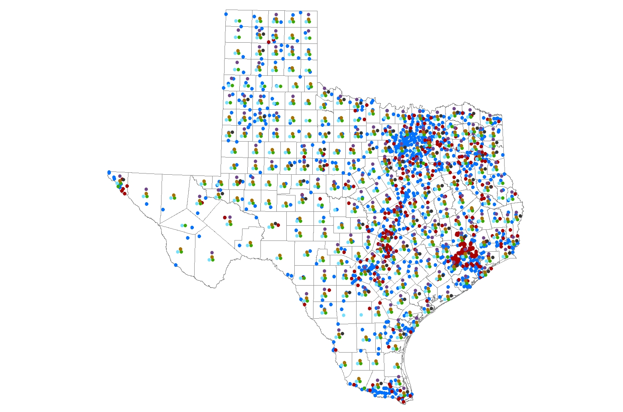
mining
Cities: 971
Utilities: 362
County-Others: 254
Manufacturing: 174
Steam-Electric: 85
Livestock: 254
Mining: 229

Slide 15

irrigation
Cities: 971
Utilities: 362
County-Others: 254
Manufacturing: 174
Steam-Electric: 85
Livestock: 254
Mining: 229
Irrigation: 239

Slide 16
≈ 3,000 Water user groups
Cities: 971 (>500 pop)
Utilities: 362
County-Others: 254
Manufacturing: 174
Steam-Electric: 85
Livestock: 254
Mining: 229
Irrigation: 239
Notes:
Statewide there are roughly 2,600 discrete water user groups considered in regional water planning
(note that many of these are actually further split up by river basin and region and county for planning purposes – and to meet statutory requirements)
(Further required county/region splits bring the actual planning wug total close to 3000)

Slide 17
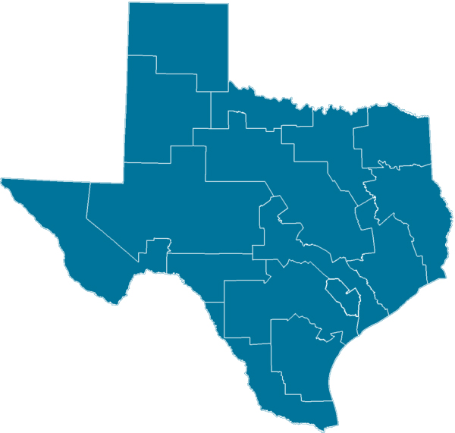
regional water Planning: by the numbers
16 regional water planning groups
12
interest groups
450 voting and non-voting planning group members
6 water demand categories
3,000
water user groups
562 recommended water management strategies to meet needs

Slide 18
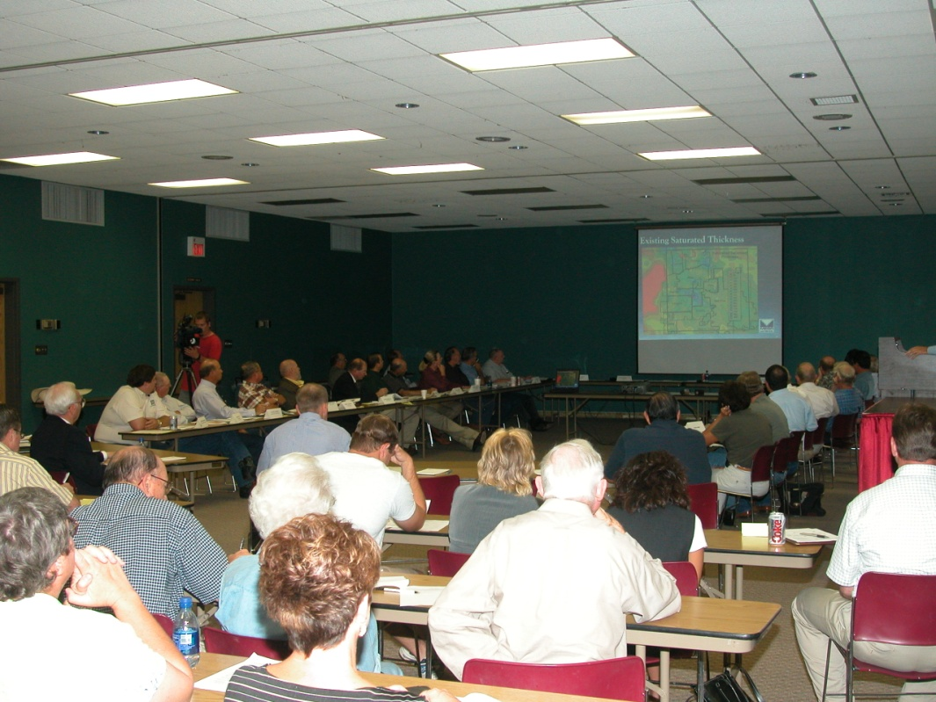
Benefits of Regional Planning
Public and planning group member education
Development of regional partnerships
Better data on water supplies
Adaptive process

Slide 20

HISTORIC AND PROJECTED TEXAS POPULATION GROWTH

Slide 21
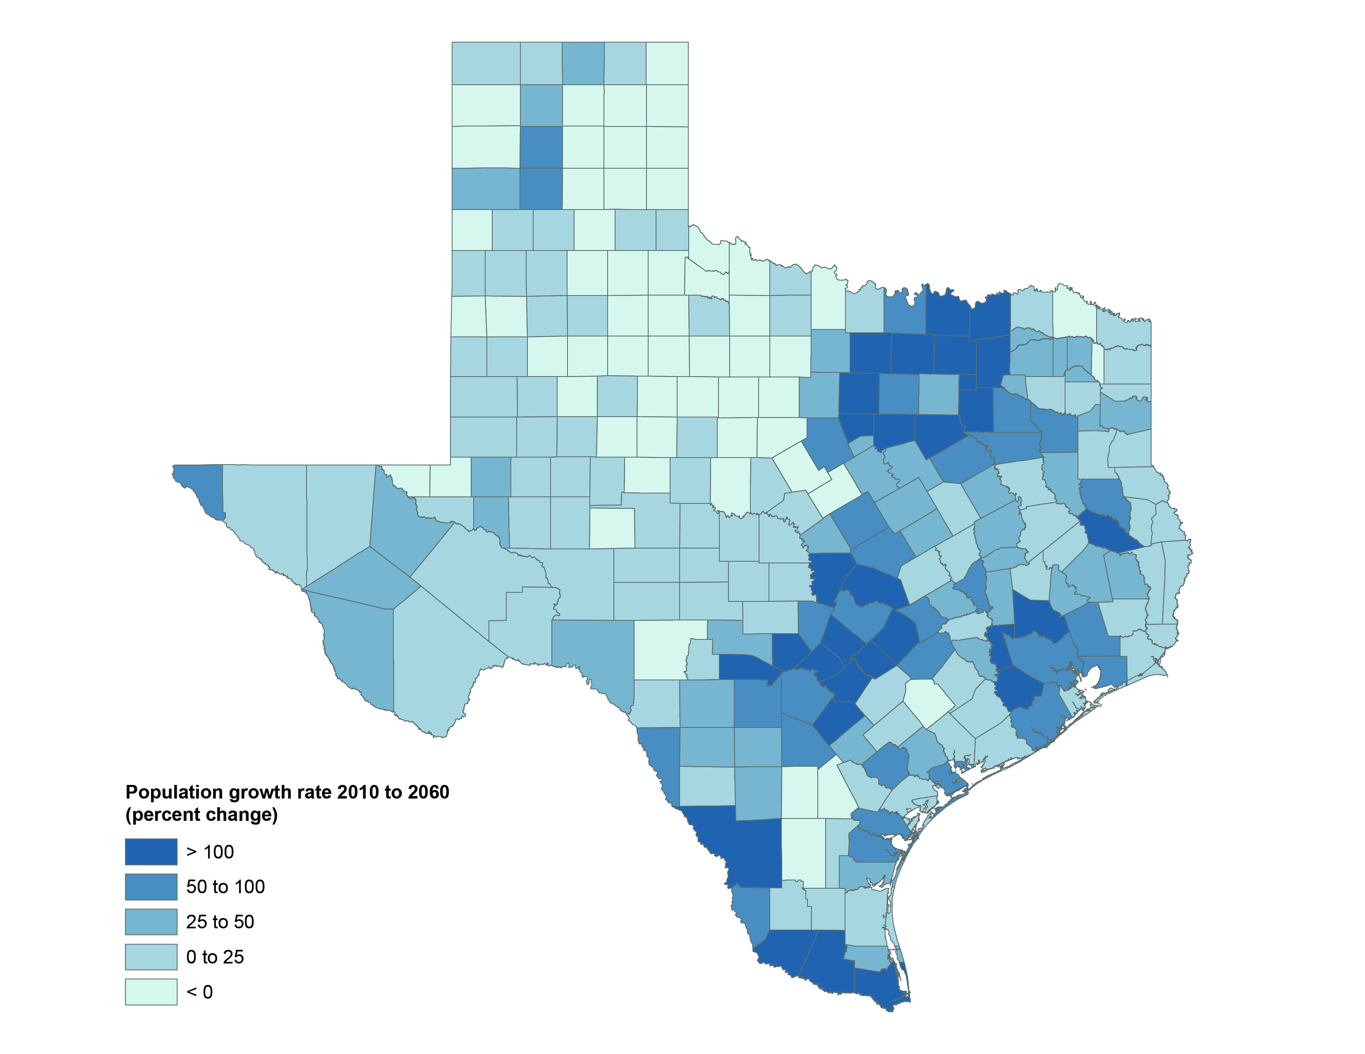
Projected population growth by county

Slide 22
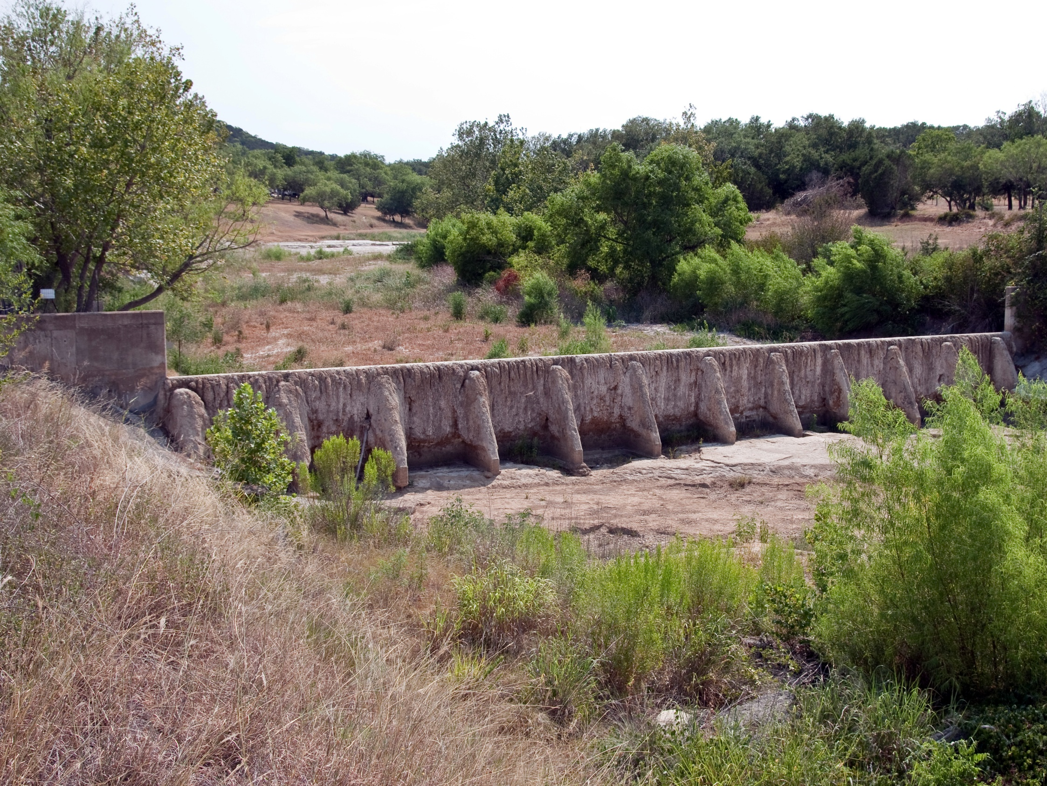
PROJECTED WATER DEMAND AND
EXISTING SUPPLIES (ACRE-FEET PER YEAR)

Slide 23
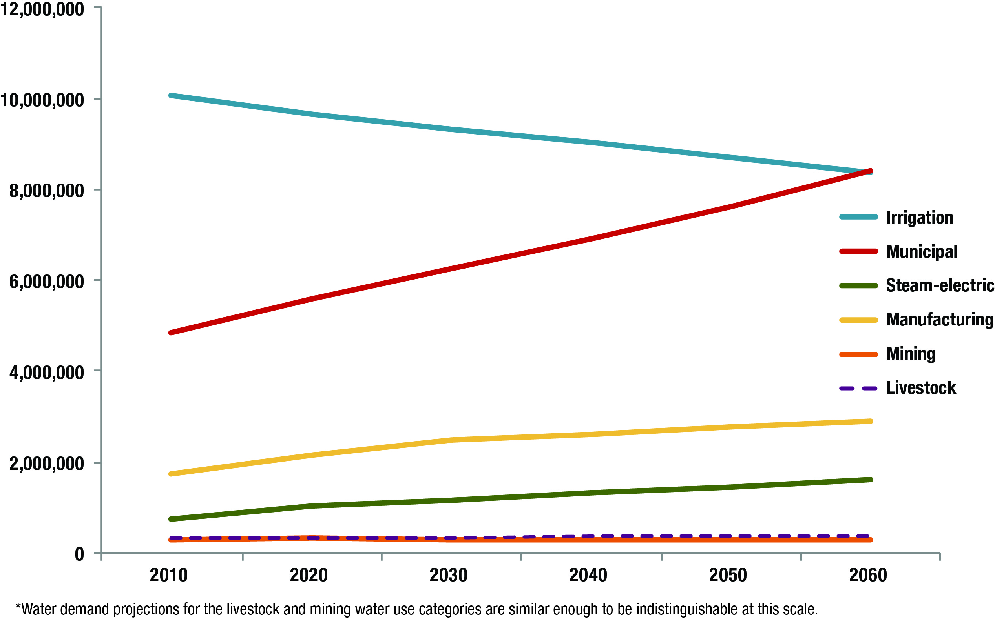
Water demand projections (acre-ft per year)

Slide 24
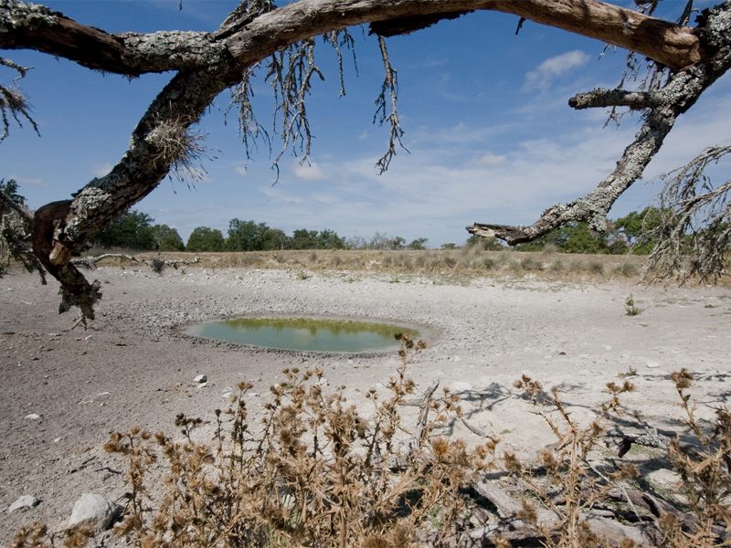
Projected needs for water during drought
During a repeat of the drought of record, the state would face an immediate need for 3.6 million acre-feet of additional water supplies.

Slide 25
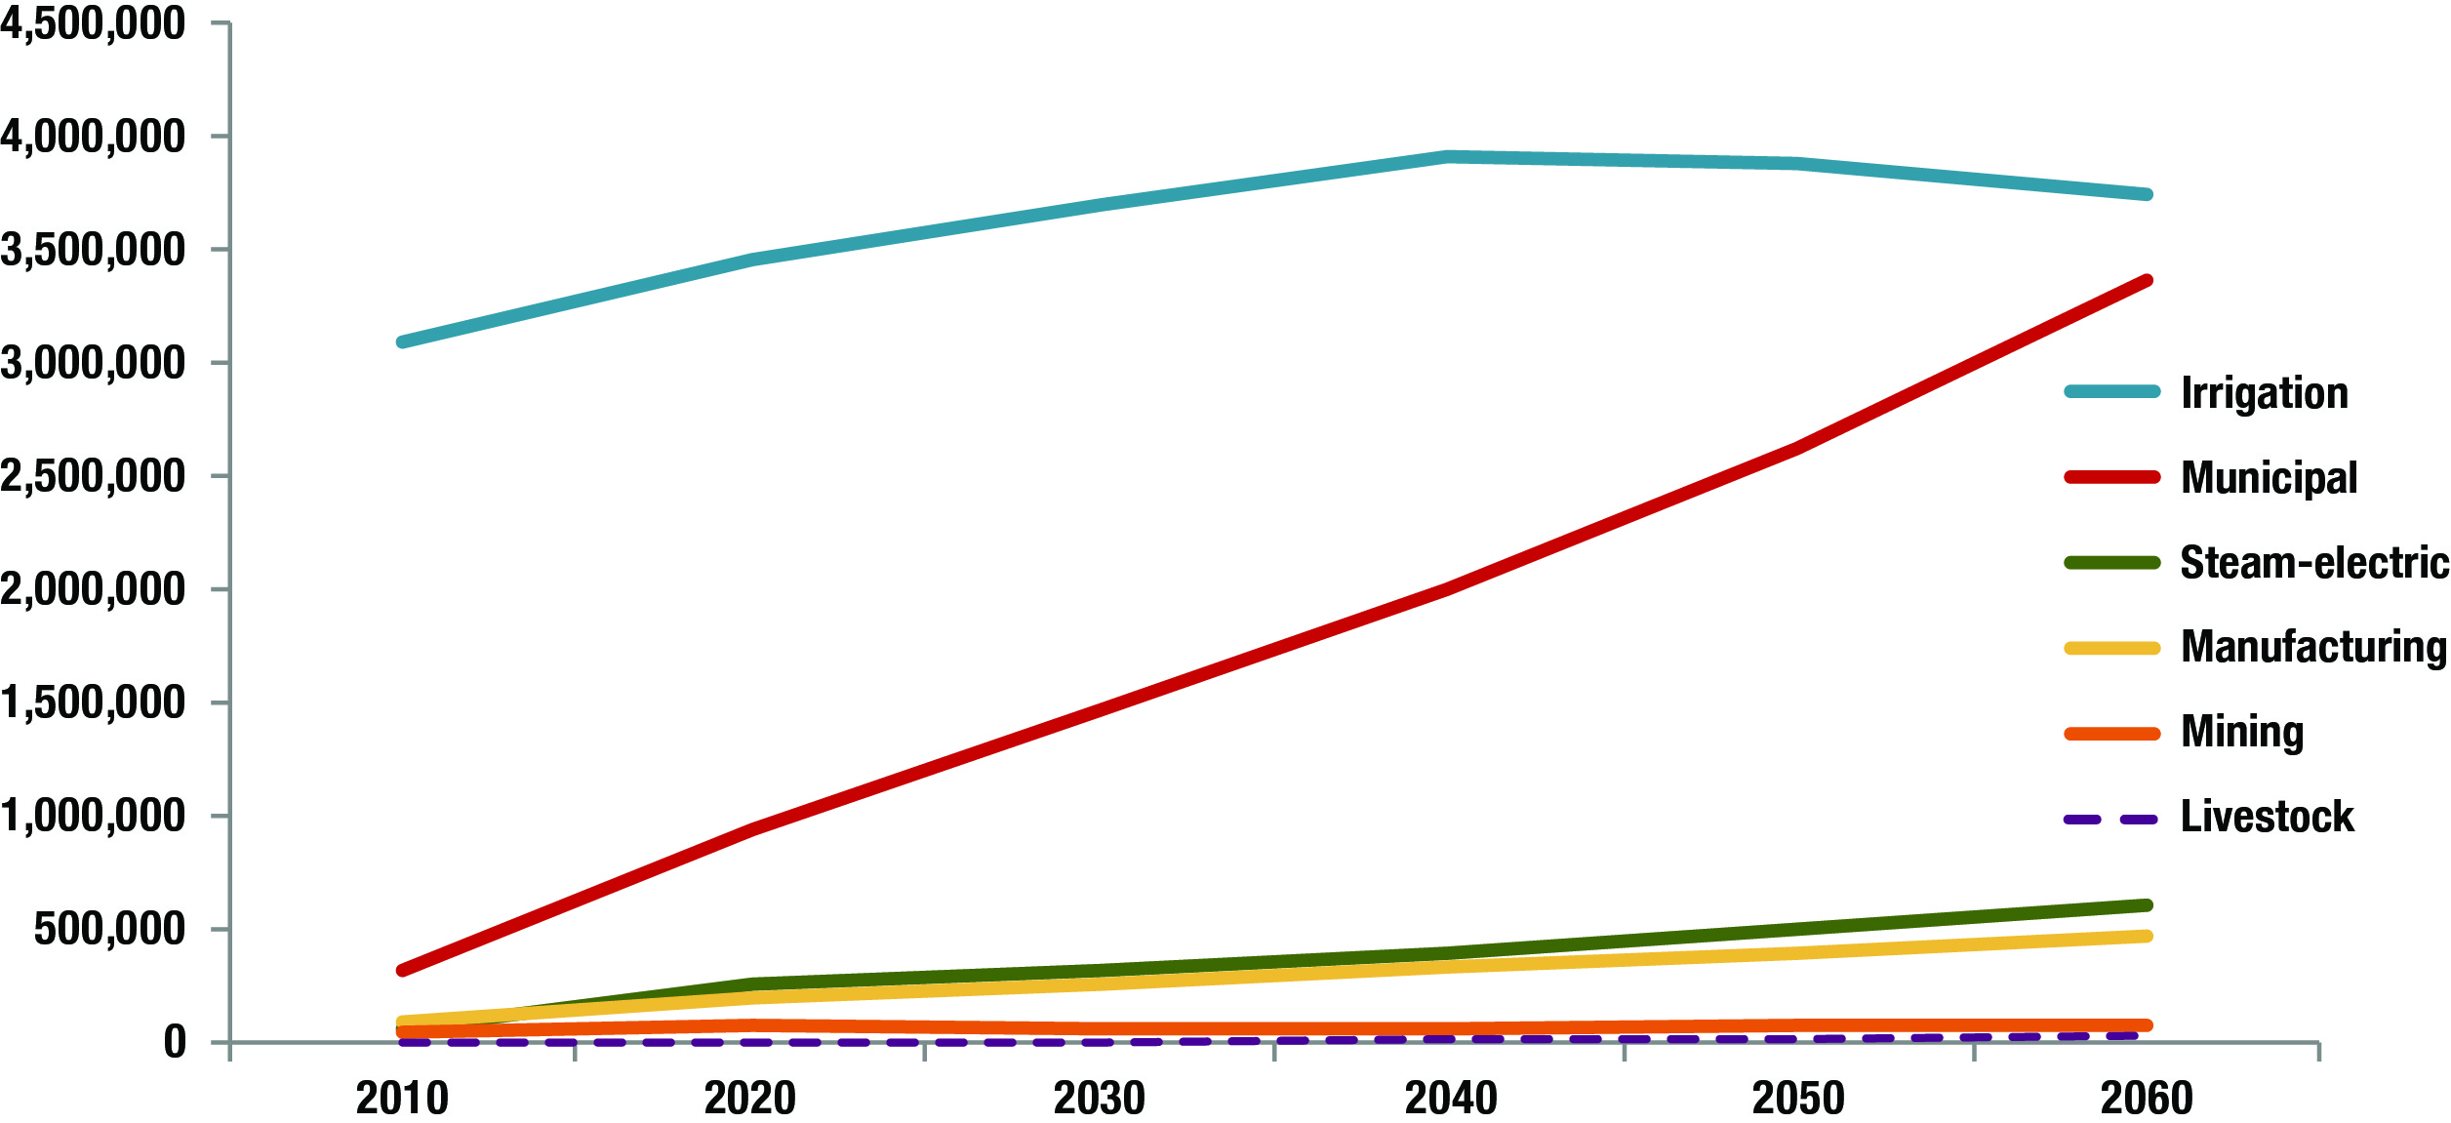
Projected water needs (Acre-ft per year)

Slide 26
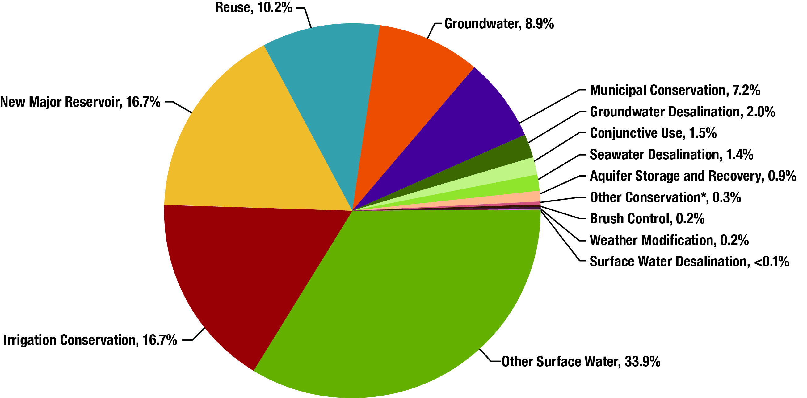
Recommended water management strategies

Slide 27
Annual average unit costs by strategy
(dollars per Acre-foot)
Notes:
27

Slide 28
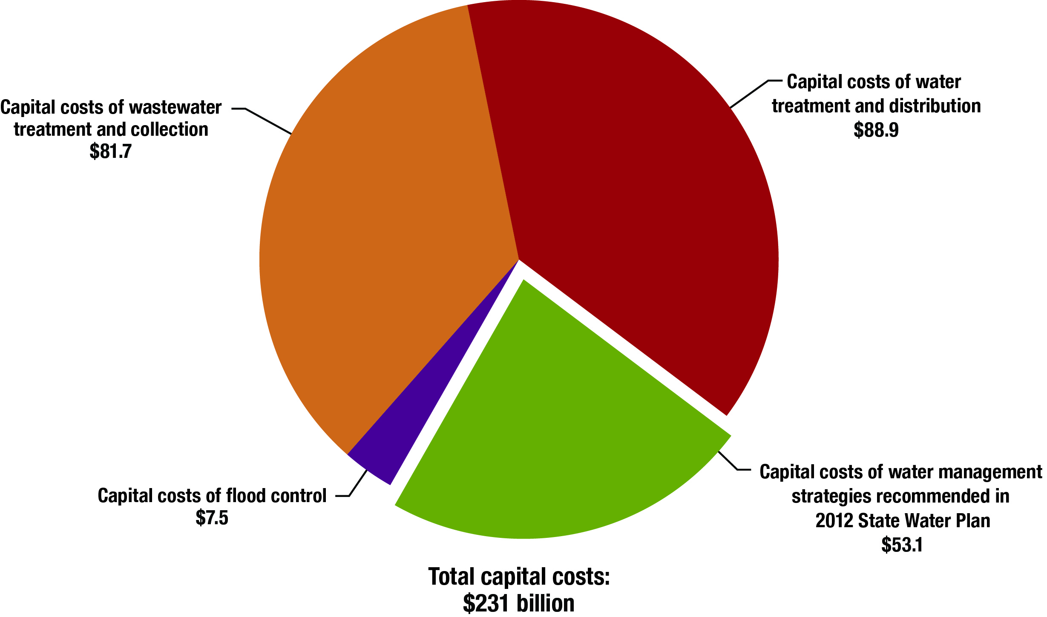
Total capital costs

Slide 29
What Happens If We Do Nothing?
Lost income:
$12 billion in 2010
$116 billion in 2060
Lost state and local business taxes:
$1 billion in 2010
$10 billion in 2060
Lost jobs:
115,000 in 2010
1 million in 2060
Lost population growth:
1.4 million in 2060

Slide 30
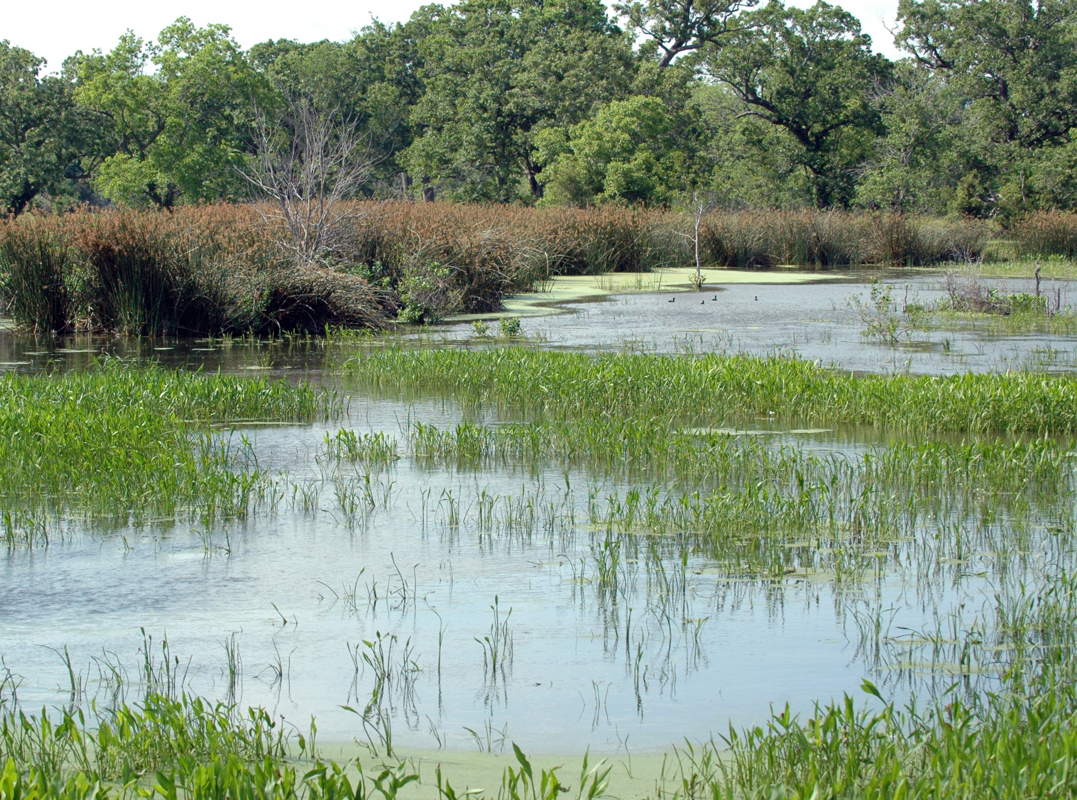
Planning is important, but . . .
IMPLEMENTING THE PLAN IS CRITICAL!
Notes:
30

Slide 31
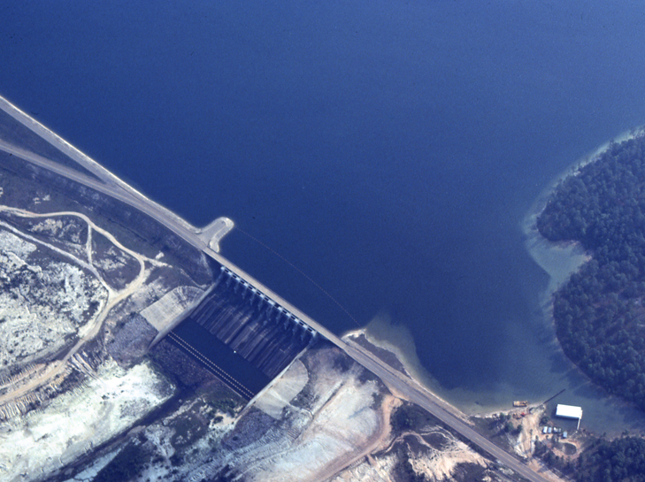
Every $1 million invested creates:
  $1.75 million sales revenues in construction, engineering, materials & supporting sectors
  $889,000 in gross state domestic product
  $44,000 in state and local tax receipts
  13 new jobs
Notes:
31

